Slide 1
How to Update VHASS Dialysis Status Board

Slide 2
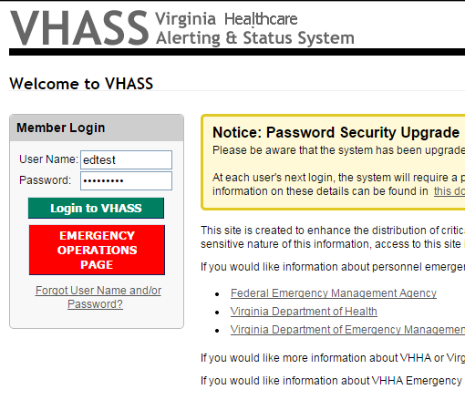
Go to: www.VHHA-MCI.org
Enter a vaild username
Enter a valid password
Click Login to VHASS

Slide 3
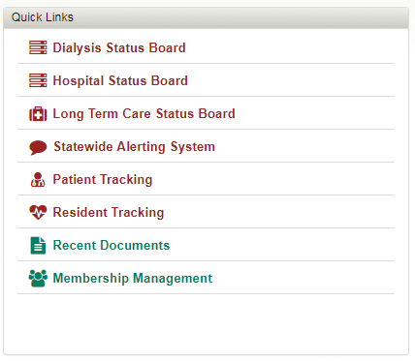
Click Dialysis Status Board

Slide 4
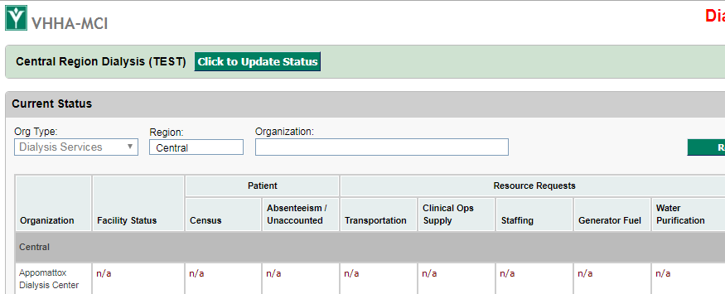
Click to Update Status

Slide 5
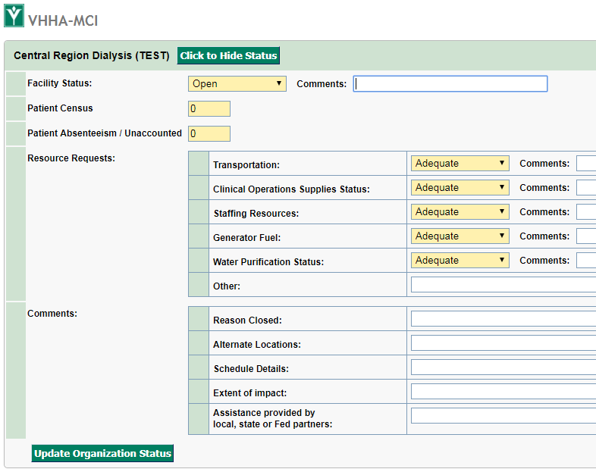
Complete all fields
Click Update Organization Status

