Slide 1
CVHC Annual Stabilization and Treatment In Place (STIP) Set-Up, Inventory and Deployment Exercise
Regional Healthcare Coordination Center

Slide 2
About the Annual STIP Exercise …
The Set-Up
Designed to deploy all the components of the STIP
Physical set up of the Base X Shelters (203, 303 & 305 Tents)
Physical set up of the Power Supplies (Generators and Lights)
Physical set up of the environmental systems (HVACs)
Physical set up of the contents (Triage and Treatment Areas)

Slide 3
About the Annual STIP Exercise …
The Inventory
Designed to confirm contents of each treatment kits
Evaluate condition of equipment inventory
Evaluate condition of containers
Evaluate current inventory for best practices and uses of equipment in the treatment kits
Remove items with anticipated or expired dates
Re-label containers and equipment as needed
Provide projections for next fiscal year STIP system needs

Slide 4
About the Annual STIP Exercise …
The Deployment
Designed to confirm and evaluate deployment needs
Evaluate the best order and practices to deploy the STIP
Provides opportunity to exercise all STIP System equipment
Provides opportunity to clean out trailers
Provides opportunity to re-arrange and re-pack the STIP System
Provides an opportunity for regional healthcare partners and CVHC staff to engage in the set-up, inventory and deployment of the STIP System

Slide 5
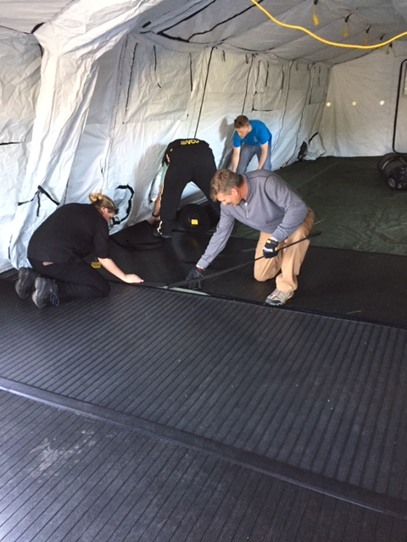
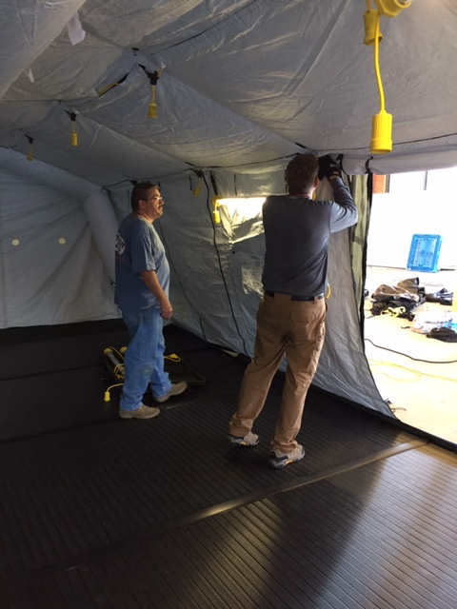
Set-up
Setting up Base X Tents
Installing floor and lights

Slide 6
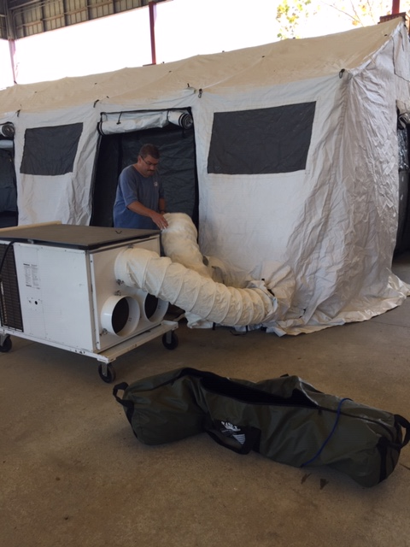
Set-up
Installing Environmental Systems
Providing Power

Slide 7
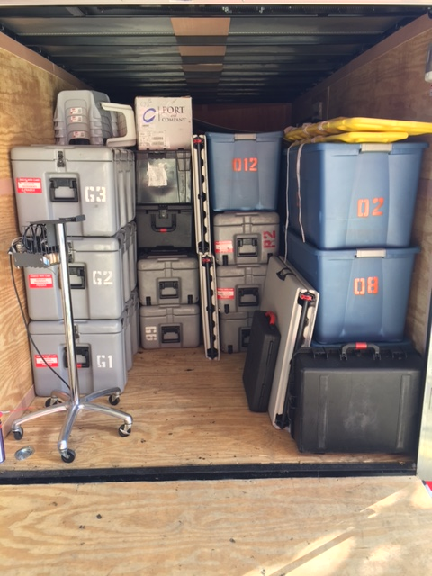
Routine Cleaning and Maintenance
Cleaning STIP Tent
Accounting and Restocking Medical Supplies

Slide 8
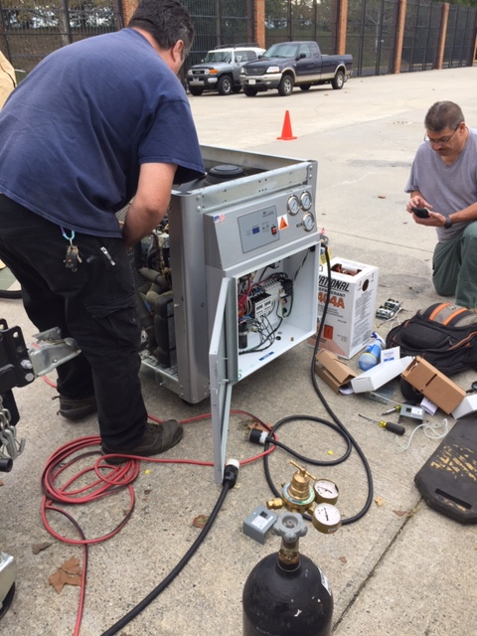
Special Maintenance and Technical Services
Painting Trailer Floors
Service Technicians checking Freon Levels

Slide 9
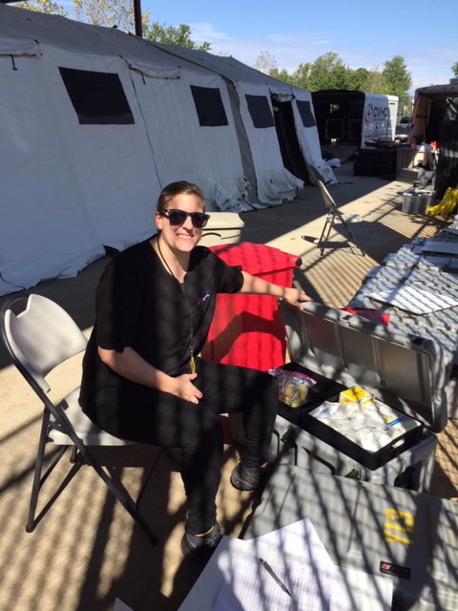
Inventory
Checking condition and expirations on items in kits
Inventory of the treatment kits

Slide 10
Deployment
Assess Deployment of Equipment
Healthcare Partner Participation
STIP System Deployed

Slide 11
Questions Thank You to all who participated
Steve Parrott, RHCC Manager
804-601-6207
steve.parrott@central-region.org
RHCC Activation: (Emergency Only) 1-800-276-0683

