Slide 1
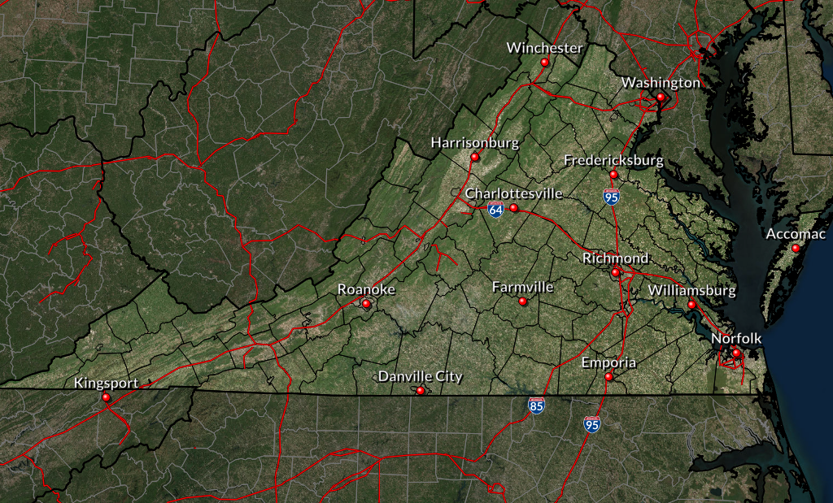
Dorian Impacts For Virginia
Thursday Night into Friday
Minor Impacts: Some nuisance flooding and possibly a few trees downed.
Rain: Up to 2 inches. Heaviest South of Richmond
Wind: 20-30 mph with gusts to 40 mph.
Moderate Impacts: Trees/power lines down, localized flooding.
Coastal Flooding: Moderate coastal flooding. Possibly major coastal flooding along the lower James River.
Rain: 2-4 inches, locally as high as 6 inches. Highest rainfall south of Williamsburg.
Wind: 30-40 mph with gusts to 45 mph.
Significant Impacts: Trees/Power Lines Downed. Some roof damage, possible flooding from heavy rain.
Coastal Flooding: Moderate to Major coastal flooding with 3 feet inundation in places. Significant Beach/Dune Erosion.
Wind: 40-50 mph with gusts to 65 mph. Highest wind gusts to 70 mph near the coast and bay.
Rain: 3-6 inches, locally as high as 8 inches. Highest rainfall Hampton Roads area.
Notes:
Days 3-4:
Expressions of uncertainty are likely being introduced into the CWF and ZFP/PNC – so ensure that what you are saying is consistent with those expressions.
IF warranted, you can discuss intensity in this slide as long as similar wording is in the NHC discussions. Generic terms should be used – This maybe a significant hurricane as it approaches the Mid-Atlantic coast.
Do not discuss intensity trends

